Slide 1


E-Farming
Post Graduate Diploma in Advanced Computing (PG-DAC)
March 2023 Batch
Group Number : 8
Guide by: Sh. Pankaj Kumar Mahto, SPE
Name | PRN
Pretesh Agarwal | 230310120022
Bhavanam Nagarjuna Reddy | 230310120005
Chaitanya Nandkishor Patil | 230310120007

Slide 2
Abstract
E-Farming is a web application developed for farmers. This application gives suppose to the village farmers who want to use this facility and who want to learn how is it possible and how they can use e-farming to sell their products.
The Farmer’s and Wholesaler’s can registered into the system. When farmer login into the system they will add the crop products and can rise complaint and Wholesaler can see the products and buy. The Admin can keep track of complaint and resolve them and view farmer and wholesaler information.
In this project It has a facility for admin login through which the admin can monitor the whole system. The facility for the sellers can update the product and set the prices of products. The facility for the buyers can check the products and buy the products with availability of the stock.

Slide 3
Objective
To provide a platform for smooth flow of food grain resources management.
To provide a user-friendly and accessible interface for both farmer and wholesaler.
The ultimate objective is to get the prediction for future food grain resource which will try to match the supply with the demand of population.
Keep a track on wholesaler about from where is he going to buy the resources at an appropriate cost.

Slide 4
Proposed System
E-Farming System not only get popularity just by providing better quality products and also the backend processing which were involved to achieve profitability.
This system will provide the platform to various farmers for their crops to be sold.
This E-Farming website will not only provide its wholesaler’s to get products list with prices but also flexibility to make comparison of prices and quantity offered by other farmers.
The farmers will add the products and if they have the products requested by wholesaler they can add that products also.

Slide 5

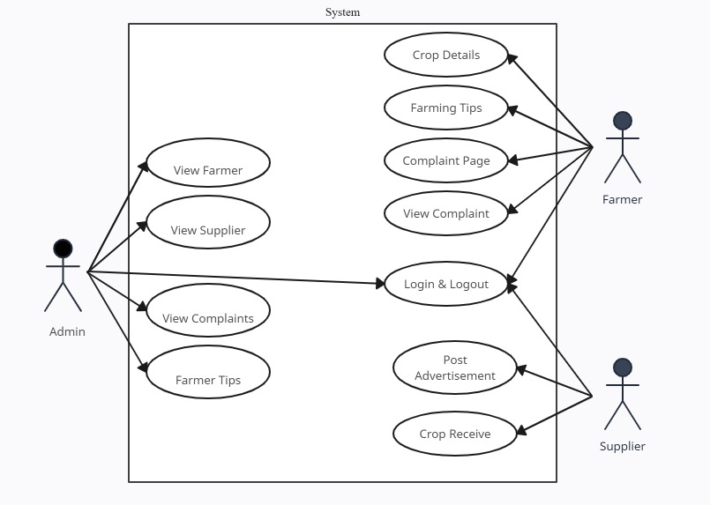
Use case diagram

Slide 6
Technology Used
Front-End: HTML5, CSS3, Bootstrap5, JavaScript
Back-End: JSP, Servlets, JDBC
Database: MYSQL Workbench

Slide 7

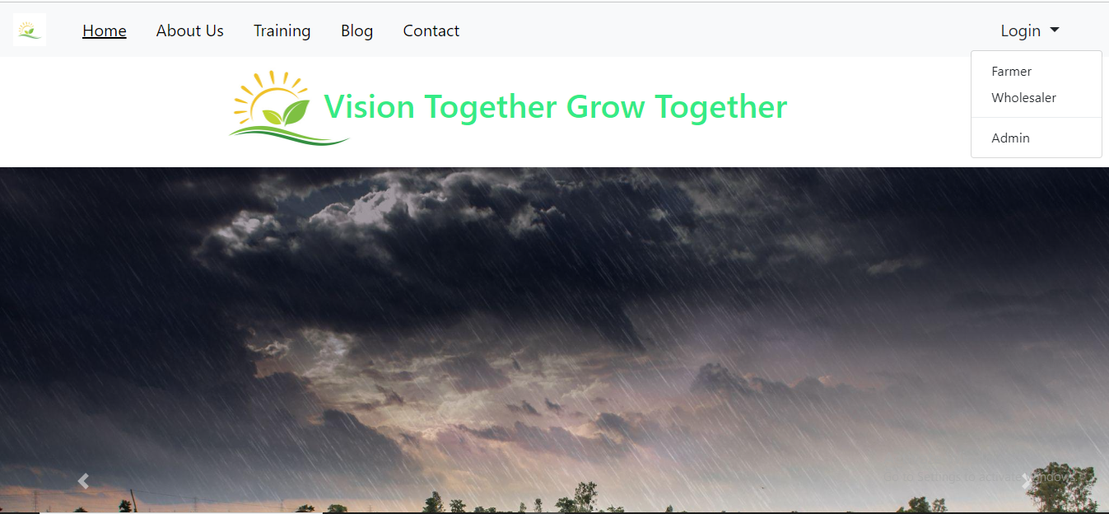
Home Page

Slide 8
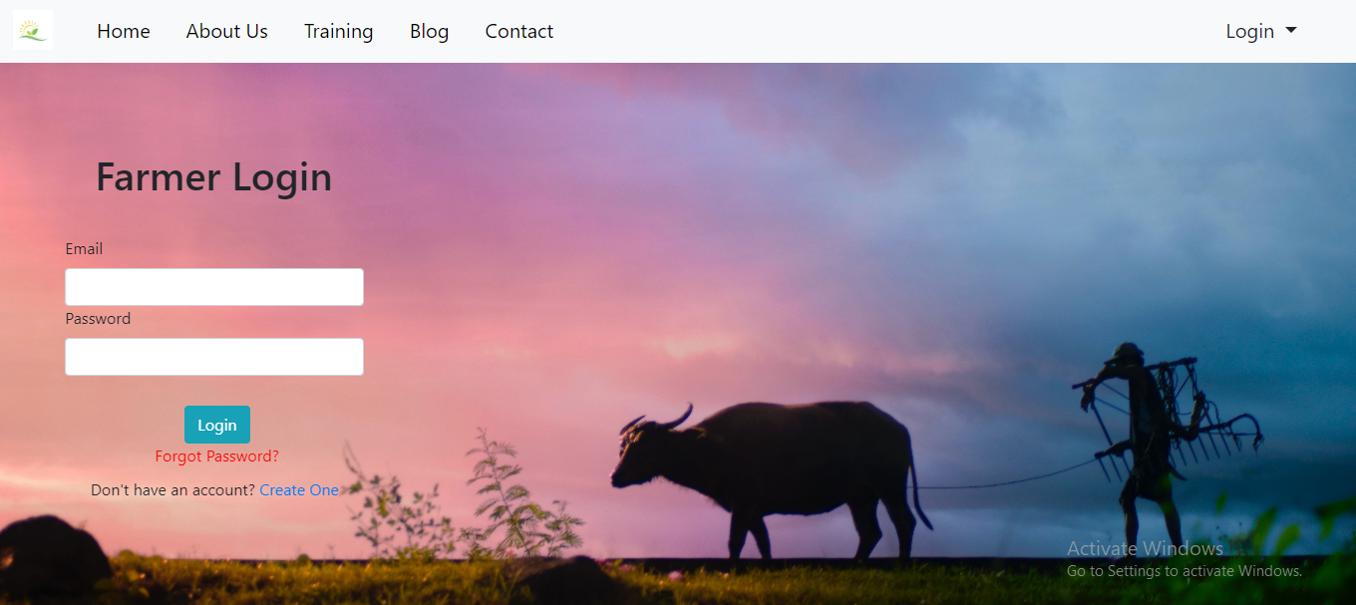
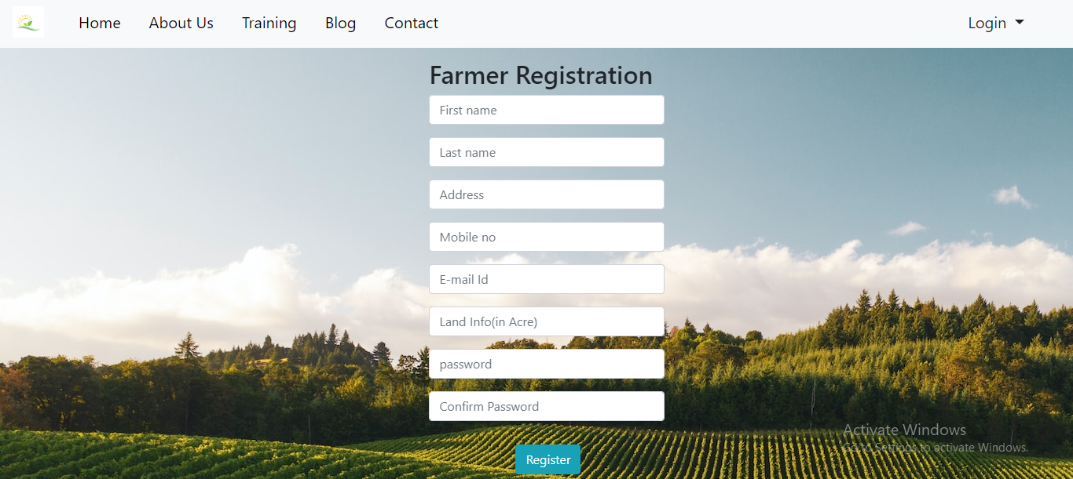
Farmer Login and Registration Page

Slide 9
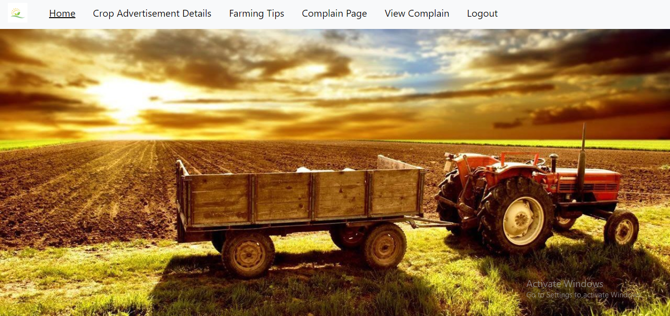
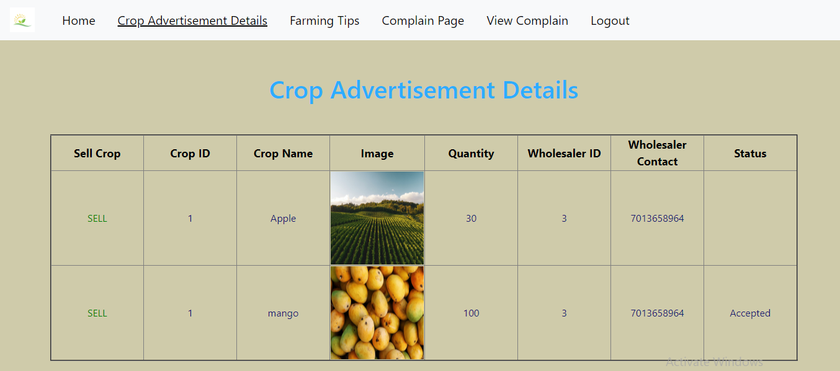
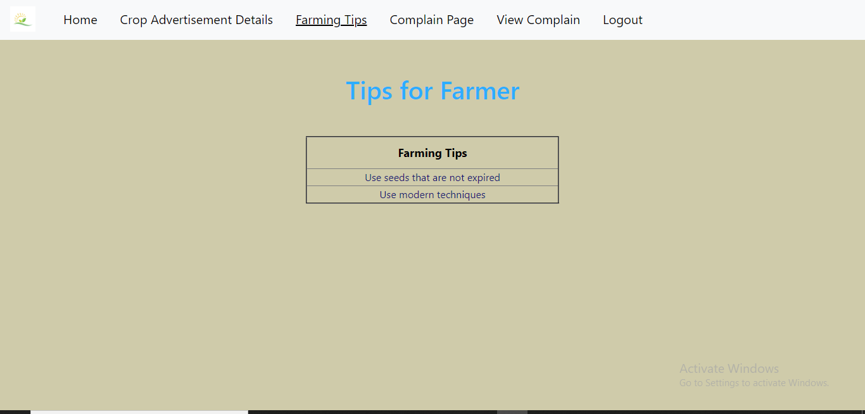
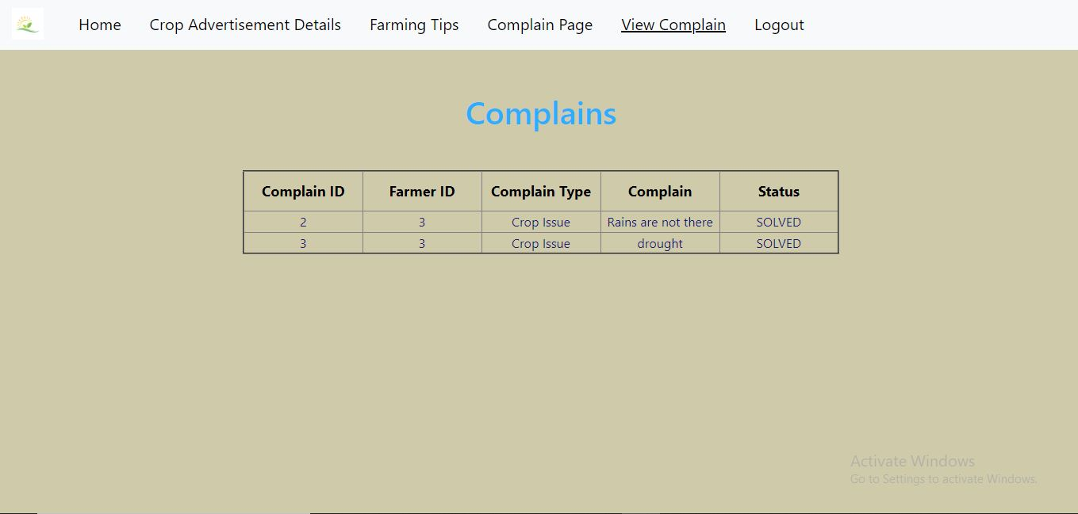
Farmer Home Page

Slide 10
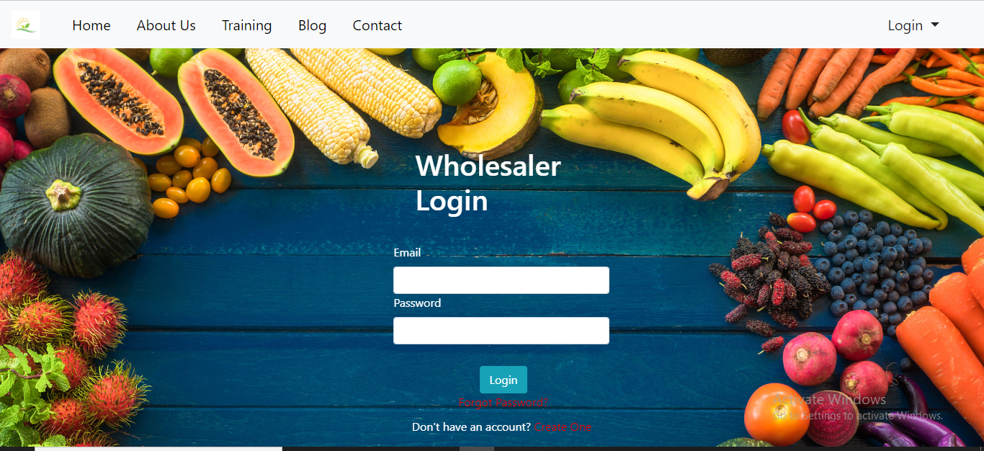
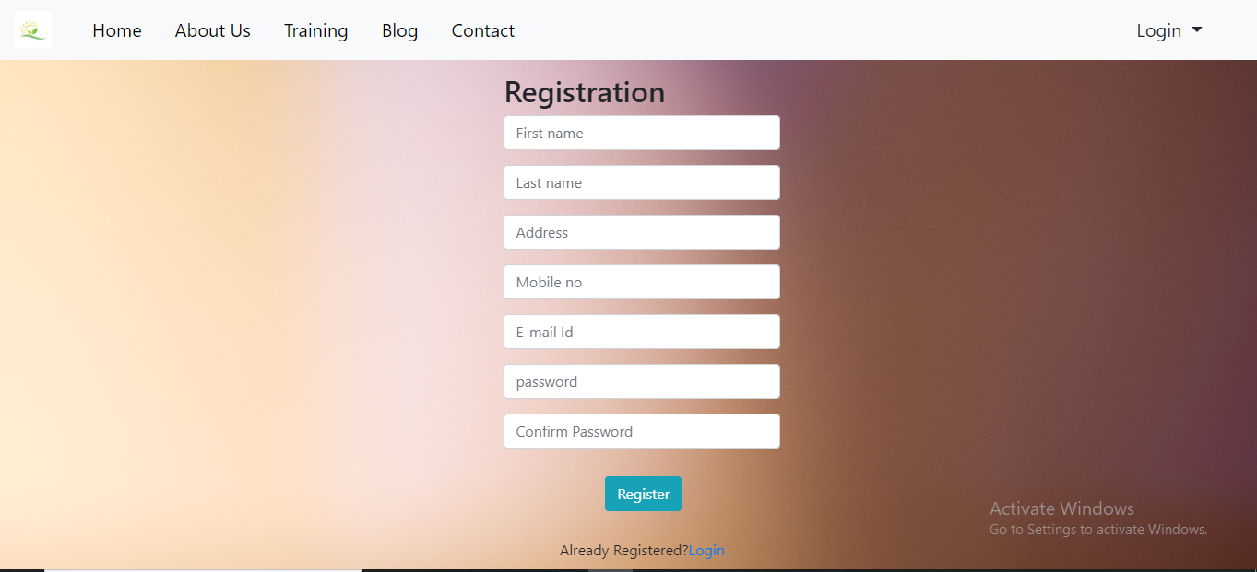
Wholesaler Login and Registration Page

Slide 11

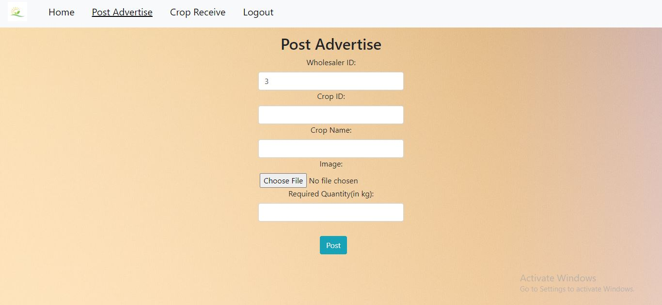
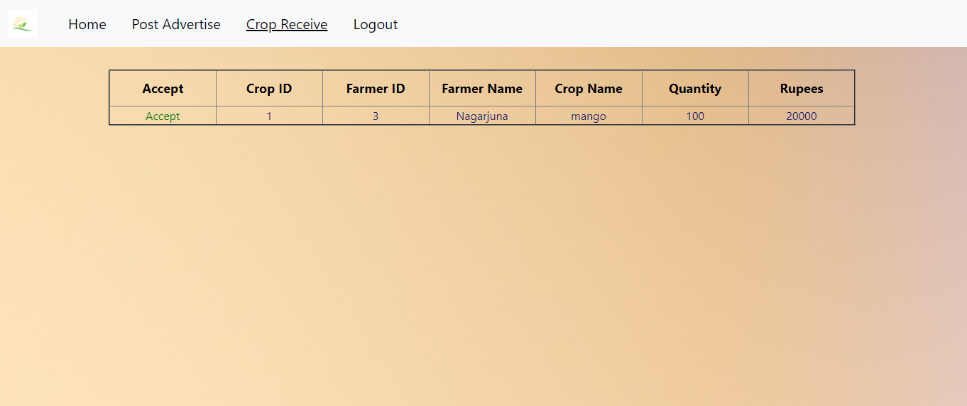
Wholesaler Home Page

Slide 12
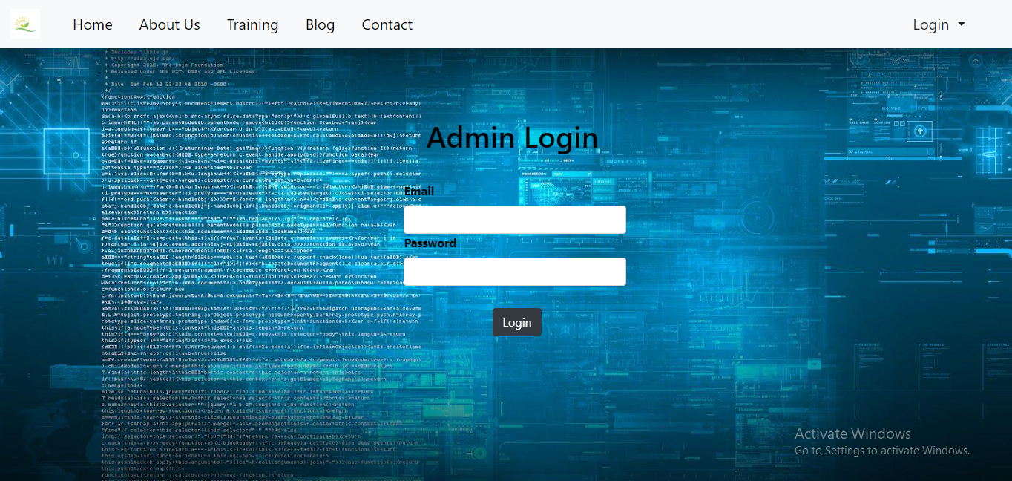
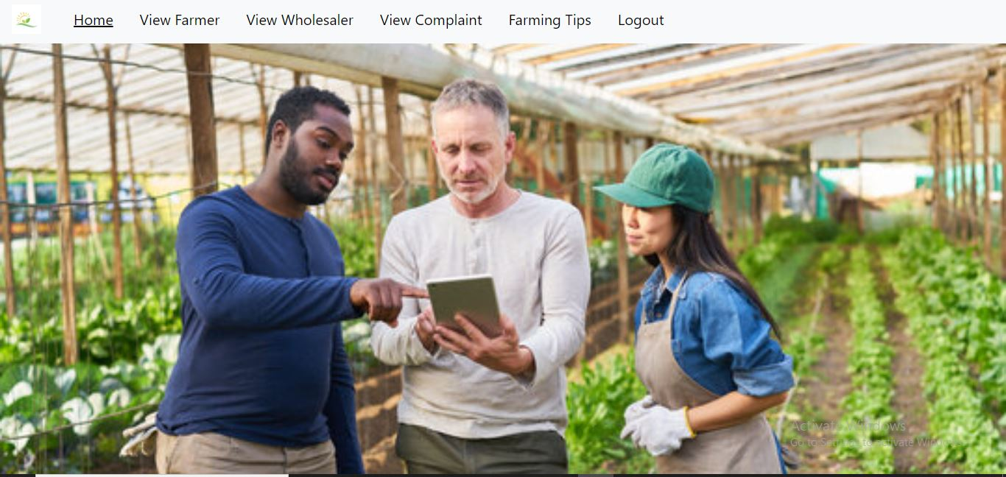
Admin Login Page
Admin Home Page

Slide 13
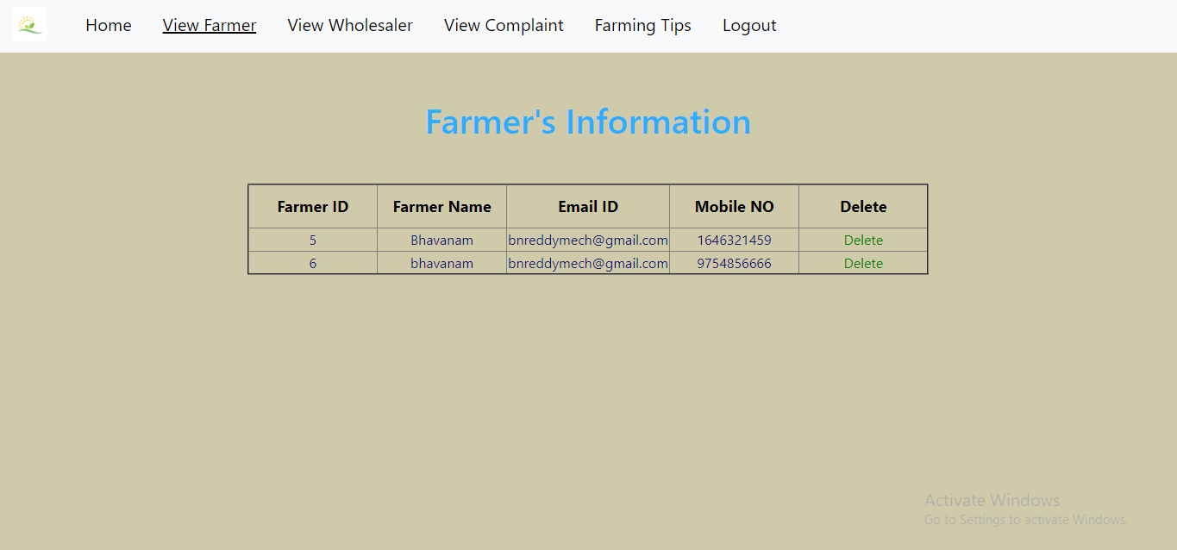
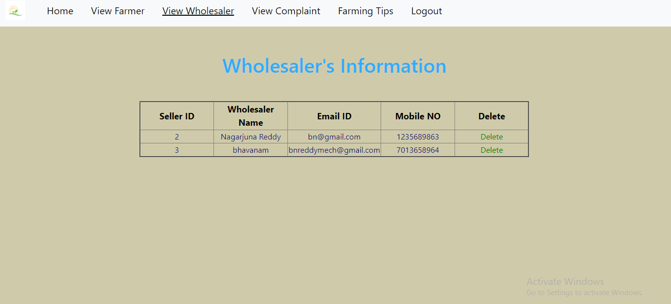
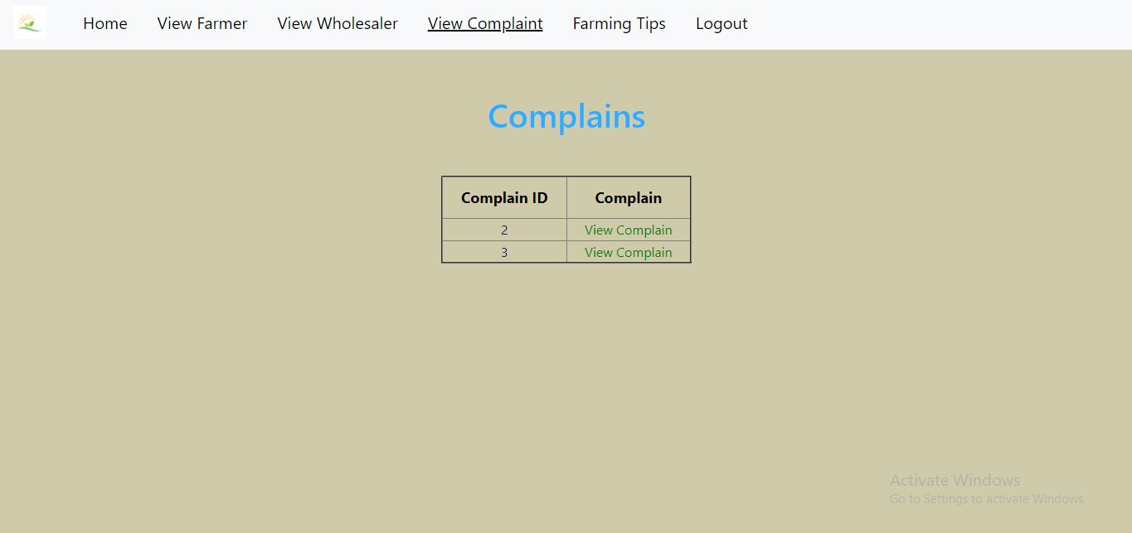
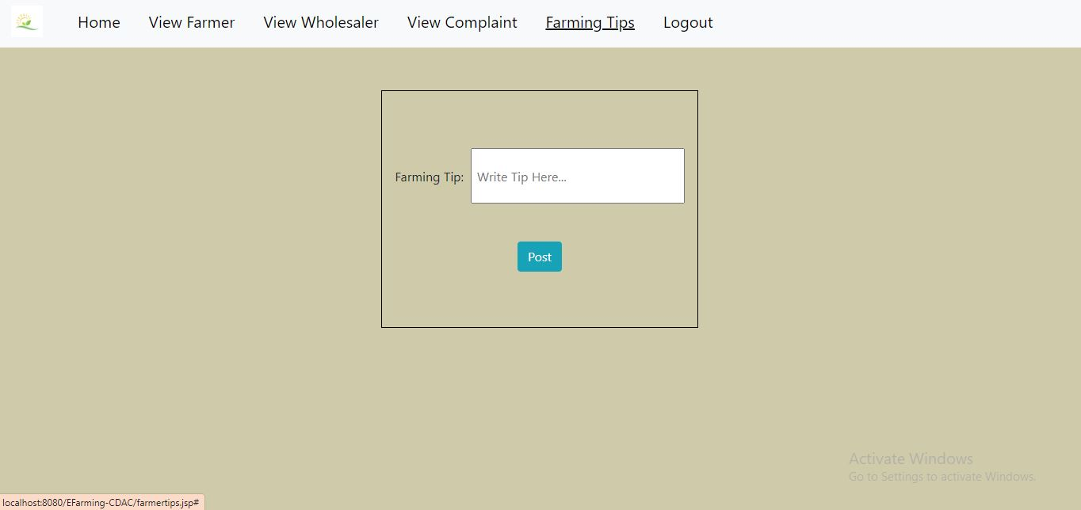
Admin Home Page

Slide 14
CONCLUSION
The ‘E-Farming’ System thus enables us to provide a wide variety of development to the ongoing chain market system which includes:
The wholesalers can request the products and buy the available products.
Cultivating and selling the food grains becomes an easy task for the farmers.
Probability of higher profit for all has increased.

Slide 15
THANK YOU

